Slide 1
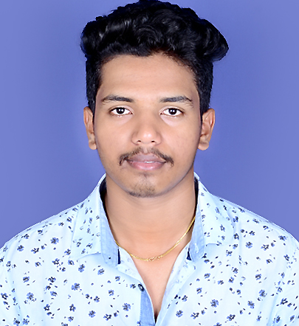

NIKHIL KUMAR
Analyst/Software Engineer
Bachelor of Engineering
Computer Science and Engineering:2017-2021
Java | Basics, OOPS, Class, Getter & Setter Method, Collection Framework, Arrays, Loops, Data Types
javaSc ript | ES6, datatypes, Functions, Event handling, Arrow Function, npm.
Spring Boot | Microservices, REST API, Test Cases using Junit, Maven Dependencies, JWT, OOPs, Eureka Server, API Gateway, SL4J Logging, Mongo Repository, Rest Controllers
UI Frame work- React | javaScript, Working with states & props in React , Event Handling in React , Routing, Life Cycle Method, HTTP Methods, Axios.
React JS | Components, Services, Modules, Routing, Forms & Validation, Testing using Jest .
Data base | MongoDB
UI Tech | HTML 5 & CSS 3,JavaScript, Materialized css.
Tools | Spring Tool Suite, Visual Studio code, Swagger, Postman, MongoDB Compass , Sonar Lint, Apache Kafka.
Add On skills | Communications, Team management. Peer learning
Mumbai
Nikhil.w.kumar@capgemini.com
+91 7338213235
A4
Proficient JAVA and OOPs concepts.
Hands on experience in creating Web Application with SpringBoot and React.
Hands on experience in developing web pages using HTML5, CSS3, Object Oriented Programming, JSON, XML. Good understanding of Document Object Model (DOM) and DOM Functions.
Practical understanding of rendering ASP.NET Web Forms, MVC Razor, REST API.
Proficient React developer with working knowledge on React.
Implemented Web API and React in case study and up skilling this knowledge continuously.
On-Demand Car Wash System Application
Working on end-to-end case study car wash system Application along with authentication, Swagger and React used for user interface.
Java and React for web developers in Degreed Platform
Completed this course with optimal Knowledge of MVC ,Web API , RESTful services , Components.

